Slide 1
Intro to Neural Networks Explained for beginners
Sajjad Mustafa

Slide 2


Problem

Slide 3
Problem
?

Slide 4
Problem

Slide 5
Problem

Slide 6
Problem

Slide 7
Linear Equation
3x + y – b = 0
3*test +academia – b = 0
If score is > 0 i.e Positive → Accept
If score is < 0 i.e Negative → Reject

Slide 8
Linear Equation Vectorized Form
w1x1 + w2x2 + b = 0
If :
W = (w1,w2)
x = (x1,x2)
y = label:
0 if False
1 if True
Then:
Wx + b = 0
ŷ → 1 if Wx + b>0
ŷ → 0 if Wx + b<0

Slide 9
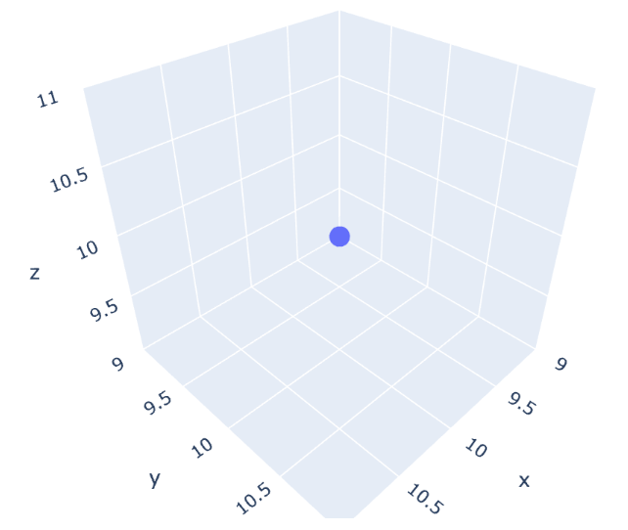
Higher Dimensional Space
w1X + w2Y + w3Z + b = 0
w1x1 + w2x2 + w3x3 + b = 0
Wx + b = 0
Wx + b = 0
ŷ → 1 if Wx + b>0
ŷ → 0 if Wx + b<0

Slide 10
N Dimensional Space
 | Test | Academia | . . . . . | . . . N
Emp1 | 5 | 2 | …. | 8
Emp2 | 8 | 7 | 6 | 9
. . | … | … | … | …
Emp n | 6 | 5 | … | 7
W1x1 + W2x2 + ….. + WnXn + b = 0
W = (w1, w2,…, w3)
x = (x1, x2, … , x3)
Wx + b = 0
Wx + b = 0
ŷ → 1 if Wx + b>0
ŷ → 0 if Wx + b<0

Slide 11
Perceptron
X1
Wx + b = 0
1 if Wx + b>0
0 if Wx + b<0
W1
X2
W2
1
b

Slide 12
Perceptron
X1
Wx + b = 0
1 if Wx + b>0
0 if Wx + b<0
W1
Yes / No
X2
W2
….
Xn
Wn
b
1

Slide 13
Human Brain
X1
Wx + b = 0
1 if Wx + b>0
0 if Wx + b<0
W1
Yes / No
X2
W2
….
Xn
Wn
b
1

Slide 14
Using Logical Gates for Perceptron AND Gate
P1 | P2 | P1 AND P2
1 | 1 | 1
1 | 0 | 0
0 | 1 | 0
0 | 0 | 0
Perceptron 1
1 / 0
AND
Perceptron 2
1 / 0

Slide 15
Using Logical Gates for Perceptron OR Gate
P1 | P2 | P1 AND P2
1 | 1 | 1
1 | 0 | 1
0 | 1 | 1
0 | 0 | 0
Perceptron 1
1 / 0
OR
Perceptron 2
1 / 0

Slide 16
Perceptron’s Training

Slide 17
Perceptron’s Training

Slide 18
Perceptron’s Training
When a Negative point is Positively Labeled, then we Subtract
Line Eq: 2x₁ + 3x₂ – 7 = 0
Wrong Point: (3,4)
3 -7
4 1 (Subtract)
-1 -1 -8
Rapid Change may Misclassify other Point
2x1 + 3x2 – 7 > 0
X2
2x₁ + 3x₂ – 7 = 0
3,4
2x1 + 3x2 – 7 < 0
X1

Slide 19
Perceptron’s Training
When a Negative point is Positively Labeled, then we Subtract
Line Eq: 2x₁ + 3x₂ – 7 = 0
Wrong Point: (3,4)
Learning Rate: 0.1 (0--1)
2 3 -7
- 3(0.1) 4(0.1) 1(0.1) (Subtract)
1.7 2.6 -7.1
New Line: 1.7x₁ + 2.6x₂ - 7.1 = 0
2x1 + 3x2 – 7 > 0
X2
2x₁ + 3x₂ – 7 = 0
3,4
2x1 + 3x2 – 7 < 0
X1

Slide 20
Perceptron’s Training
When a Positive point is Negatively Labeled, then we Add
Line Eq: 2x₁ + 3x₂ – 7 = 0
Wrong Point: (4,1)
Learning Rate: 0.1 (0--1)
2 3 -7
+ 4(0.1) 1(0.1) 1(0.1) (Add)
2.4 3.1 -6.9
New Line: 2.4x₁ + 3.1x₂ - 6.9 = 0
2x1 + 3x2 – 7 > 0
X2
2x₁ + 3x₂ – 7 = 0
4,1
2x1 + 3x2 – 7 < 0
X1

Slide 21
Perceptron Algorithm
Loop over all Points
Start with random Weights
If point is classified correctly
Move on
If point is misclassified
If prediction is 0
Change w_{i} + ax_{i}
If prediction is 1
Change w_{i} - ax_{i}

Slide 22
Problem With “Linear Solutions”
We don’t want
to hire an
employee with
such a bad
“academic record“

Slide 23
Problem With “Linear Solutions”

Slide 24
Possible Solution to the Problem

Slide 25
Possible Solution to the Problem

Slide 26
Error Function

Slide 27

Error Function
Error : Height

Slide 28
Error Function
Error = 2

Slide 29
Error Function
Error = 2

Slide 30

Discrete vs Continuous
Error : Height

Slide 31
Log Loss Error Function
Error = 0.1+0.1+0.1+5 + 0.1+0.1+0.1+5

Slide 32
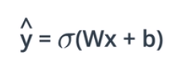
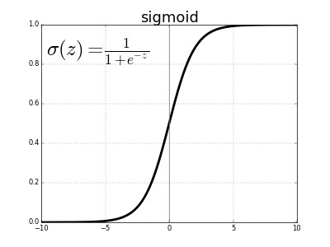
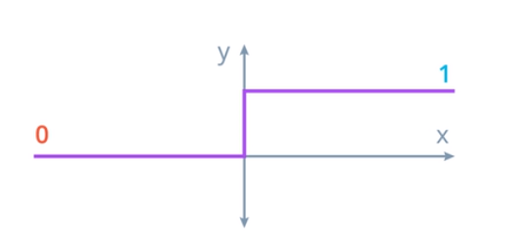
Activation Function

Slide 33
Step Function
X1
Wx + b = 0
1 if Wx + b>0
0 if Wx + b<0
W1
1
X2
W2
0
….
Xn
Wn
b
1

Slide 34
Step Function
X1
Wx + b = 0
1 if Wx + b>0
0 if Wx + b<0
W1
0.6
X2
W2
0.3
….
0.1
Xn
Wn
b
1

Slide 35

Multi-Class Classification
Chances of Rain:
60%(0.6) YES
40%(0.4) NO

Slide 36

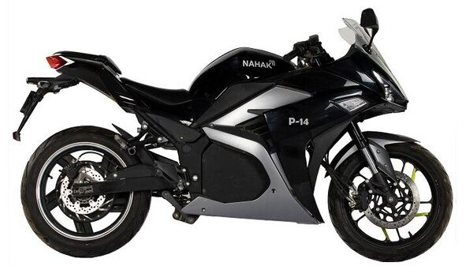
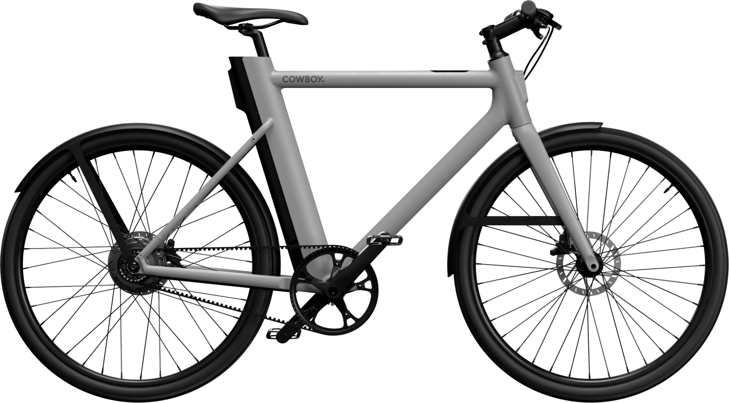
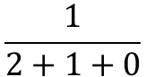
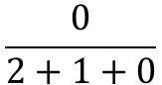
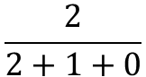
Multi-Class Classification
P(Car) = 0.67
P(Bike) = 0.24
P(Bi-Cycle) = 0.09
Score = 2
Score = 1
Score = 0
$$\frac{2}{2+1+0}$$
$$\frac{1}{2+1+0}$$
$$\frac{0}{2+1+0}$$
Problem: Negative Numbers

Slide 37
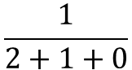
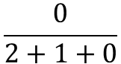
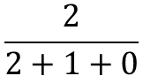
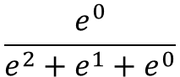
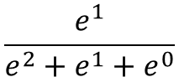
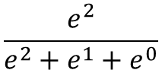
Softmax Function
P(Bi-Cycle) = 0.09
P(Car) = 0.67
P(Bike) = 0.24
Score = 2
Score = 1
Score = 0
$$\frac{2}{2+1+0}$$
$$\frac{1}{2+1+0}$$
$$\frac{0}{2+1+0}$$
$$\frac{e^{2}}{e^{2}+e^{1}+e^{0}}$$
$$\frac{e^{1}}{e^{2}+e^{1}+e^{0}}$$
$$\frac{e^{0}}{e^{2}+e^{1}+e^{0}}$$

Slide 38
Quiz
Write a function in python that’ll receive a list of numbers and returns a list that contains the Softmax value of every number.

Slide 39

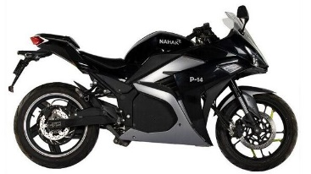
One Hot Encoding
Vehicle | Value
 | 0
 | 1
 | 2

Slide 40

One Hot Encoding
Vehicle | Car | Bike | Bi-Cycle
 | 1 | 0 | 0
 | 0 | 1 | 0
 | 0 | 0 | 1

Slide 41
Maximum Likelihood
Model A
Model B

Slide 42
Maximum Likelihood
Model A
0.9 * 0.4 * 0.3 * 0.8 = 0.0864
Model B
0.6 * 0.8 * 0.7 * 0.9 = 0.3024
P(green)=0.9
P(green)=0.6
P(red)=0.1
P(green)=0.6
P(red)=0.4
P(red)=0.7
P(green)=0.3
P(green)=0.8
P(red)=0.7
P(green)=0.2
P(red)=0.8
P(red)=0.9
Model A
Model B

Slide 43
Error vs Probability
Probability
Error

Slide 44
Maximizing Probabilities
P(green)=0.9
P(green)=0.6
Product
Model A
0.9 * 0.4 * 0.3 * 0.8 = 0.0864
Model B
0.6 * 0.8 * 0.7 * 0.9 = 0.3024
P(red)=0.1
P(green)=0.6
P(red)=0.4
P(red)=0.7
P(green)=0.3
P(green)=0.8
P(red)=0.7
P(green)=0.2
P(red)=0.8
P(red)=0.9
Model A
Model B
Products are bad
Sums are Good

Slide 45
Quiz
Which Function can be used to replace product with Sums?
Sin
Cos
Exp
Log
Log(ab) = Log(a)+Log(b)

Slide 46
Cross-Entropy
Goal is to minimize the Cross-Entropy
Model A
0.9 * 0.4 * 0.3 * 0.8 = 0.0864
Log(0.9) + Log(0.4) + Log(0.3) + Log(0.8) = -1.06348625752
-Log(0.9) -Log(0.4) -Log(0.3) -Log(0.8) = 1.06348625752
Model B
0.6 * 0.8 * 0.7 * 0.9 = 0.3024
Log(0.6) + Log(0.8) + Log(0.7) + Log(0.9) = -0.51941821317
-Log(0.6) -Log(0.8) -Log(0.7) -Log(0.9) = 0.51941821317

Slide 47
Events vs Probability
Events
Probability
Cross-Entroppy

Slide 48
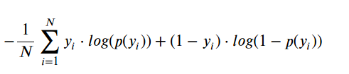
Cross-Entropy Formulation
Cross-Entropy
-ln(0.8) - ln(0.1)
P1 = 0.8
P2 = 0.1
Y: 1 if selected
Y: 0 if NOT selected
Selected
NOT Selected
P(selected) = 0.8
P(selected) = 0.9
p1
1 - p2
Y1 = 1
Y2 = 0

Slide 49
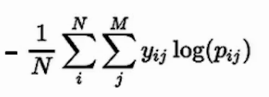


Cross-Entropy for Multi-class
Vehicle | G1 | G2 | G3
 | 0.8 p11 | 0.3 p12 | 0.2 p13
 | 0.1 p21 | 0.1 p22 | 0.6 p23
 | 0.1 p31 | 0.6 p32 | 0.2 p33

Slide 50
Quiz
What is relation between cross-Entropy and Probability?
Directly proportional
Inversely proportional

Slide 51
Minimizing the Error Function
Gradient Decent

Slide 52
Gradient Decent
Error : Height
Convex Function

Slide 53
Convex Functions
Curve is like a bowl
Derivatives possible

Slide 54
Derivatives
When: a = 1 → f(a) = 2
When: a = 5 → f(a) = 10
When: a = 5.001 → f(a) = 10.002
Slope = height/width
Derivatives are also called Slopes.
F(a) = 2a

Slide 55
How Gradient Decent Works

Slide 56
Gradient Step
Wi’ = Wi – learningRate (d/dE)
→ Wi’ = Wi – learningRate (-(y - yhat)xi )
→ Wi’ = Wi + learningRate (y - yhat)xi
b’ = b + learningRate(y – yhat)

Slide 57
Logistic Regression Algorithm
Start with random weights
w1, w2,……., wn, b
For Every point(x1, x2,……, xn)
Update W’
Update b’
Repeat until error is small
Perceptron Algorithm?

Slide 58
To Do
Sigmoid activation function
𝜎(𝑥)=1/1+𝑒−𝑥
Output (prediction) formula
yhat=𝜎(𝑤1𝑥1+𝑤2𝑥2+𝑏)
Error function
𝐸𝑟𝑟𝑜𝑟(𝑦,yhat)=−𝑦log(yhat)−(1−𝑦)log(1− yhat)
The function that updates the weights
𝑤𝑖⟶𝑤𝑖+𝛼(𝑦− yhat)𝑥𝑖
𝑏⟶𝑏+𝛼(𝑦− yhat)

Slide 59
Perceptron VS Gradient Decent
Gradient Decent
Start with random weights
w1, w2,……., wn, b
For Every point(x1, x2,……, xn)
Update W’
Update b’
Repeat until error is small
Perceptron Algo
Loop over all Points
Start with random Weights
If point is classified correctly
Move on
If point is misclassified
If prediction is 0
Change w_{i} + ax_{i}
If prediction is 1
Change w_{i} - ax_{i}

Slide 60
Problem With “Linear Solutions”
We don’t want
to hire an
employee with
such a bad
“academic record“

Slide 61
Problem With “Linear Solutions”

Slide 62
Possible Solution to the Problem

Slide 63
Possible Solution to the Problem

Slide 64
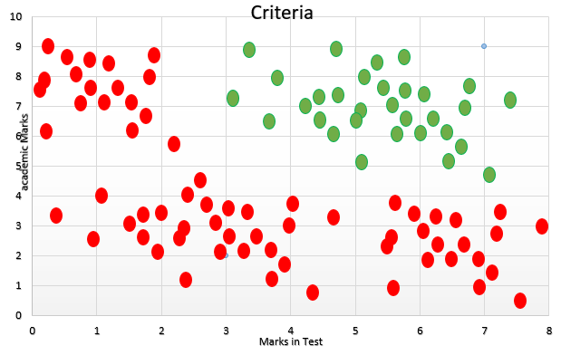
Non-Linear Boundaries

Slide 65
Non-Linear Boundaries
0.7
0.7 + 0.8 = 1.5
0.8
Sigmoid(1.5) = 0.82

Slide 66
Weighted Sums
0.7
6
6 * 0.7
4.2 + 3.2 - 3 = 4.4
0.8
4
4 * 0.8
Sigmoid(4.4) = 0.98

Slide 67
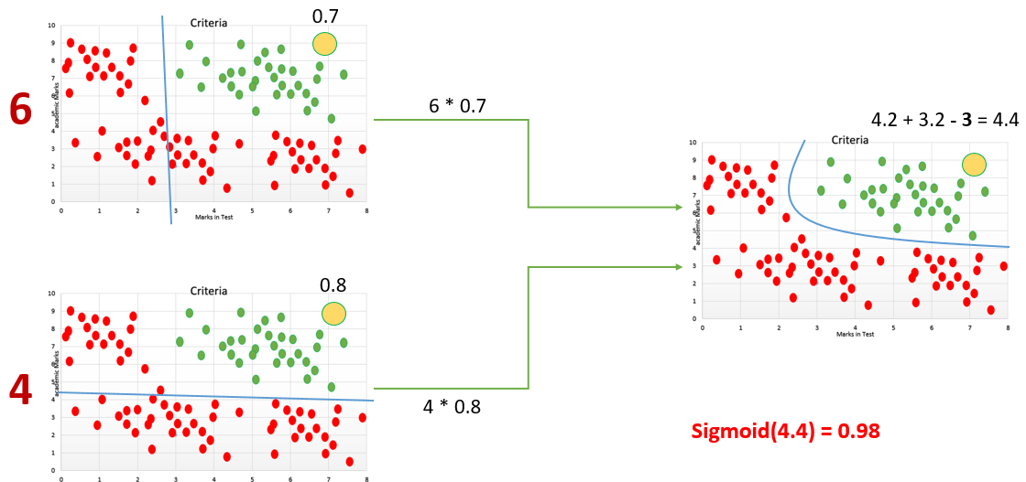
Neural Networks
6
-3
4

Slide 68
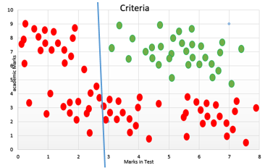
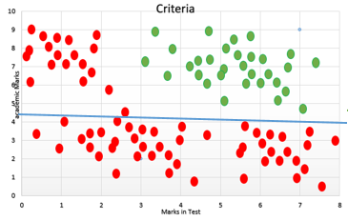
Neural Networks
5x₁ - 2x₂ + 8
5
8
-2
7x₁ - 3x₂ - 1
7
-1
-3

Slide 69
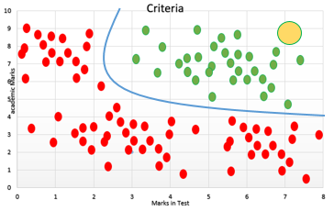
Neural Networks
5x₁ - 2x₂ + 8
5
7
8
-2
7
-6
7x₁ - 3x₂ - 1
5
7
5
-1
-3

Slide 70
Neural Networks
5x₁ - 2x₂ + 8
X1
5
7
8
-2
X2
7
-6
7x₁ - 3x₂ - 1
X1
5
7
5
-1
-3
X2

Slide 71
Neural Networks
5x₁ - 2x₂ + 8
7
5
8
X1
7
7
-6
7x₁ - 3x₂ - 1
5
-2
X2
-1
5
-3

Slide 72
Adding Bias
5
X1
7
7
-2
X2
5
-3
8
1
-6
1
1

Slide 73
Architecture
INPUT Layer
Hidden Layer
Output Layer
5
X1
7
7
-2
X2
5
-3
8
1
-6
1
1

Slide 74
DEEP Neural Network
5
X1
7
-2
X2
-3
8
1
1
1
1
1

Slide 75
Multi-Class Classification
5
X1
7
-2
X2
-3
8
1
1
1
1
1

Slide 76
Feed Forward
X1
w₁₁
w₃₁
w₁₂
w₂₁
X2
w₃₂
w₂₂

Slide 77
Feed Forward
X1
w₁₁
w₃₁
w₁₂
w₂₁
X2
w₃₂
w₂₂

Slide 78
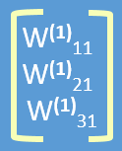
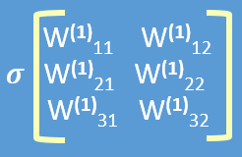

Feed Forward
Yhat = 𝜎
W⁽¹⁾₁₁
W⁽²⁾₁₁
X1
W⁽¹⁾₁₂
Yhat = 𝜎 ( W² 𝜎 (W¹) X )
W⁽¹⁾₂₁
W⁽²⁾₁₁
X2
W⁽¹⁾₂₂
W⁽¹⁾₃₁
1
1
W⁽²⁾₁₁
W⁽¹⁾₃₂

Slide 79
DNN Feed Forward
Yhat = 𝜎 o W⁴ 𝜎 o W³ 𝜎 o W² 𝜎 o W¹(X)
W¹
W²
W³
X1
W⁴
X2
1
1
1
1

Slide 80
Deep Learning Algorithm
Doing a feedforward operation.
Comparing the output of the model with the desired output.
Calculating the error.
Running the feedforward operation backwards (backpropagation) to spread the error to each of the weights.
Use this to update the weights, and get a better model.
Continue this until we have a model that is good.

Slide 81
Back Propagation
X1
w₁₁
w₃₁
w₁₂
w₂₁
X2
w₃₂
w₂₂

Slide 82
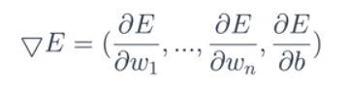
Back Propagation
Prediction
X1
W1
Error Function
X2
E(W) =
W2
….
Xn
Wn
Gradient of Error Function
b
1

Slide 83
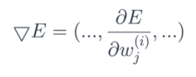
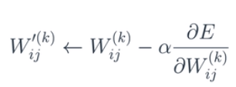
Back Propagation in Deep Net
Yhat = 𝜎 o W⁴ 𝜎 o W³ 𝜎 o W² 𝜎 o W¹(X)
Error Function
W¹
W²
W³
E(W) =
X1
W⁴
Gradient of Error Function
X2
1
1
1
1

Slide 84
Chain Rule
W¹
W²
W³
X1
W⁴
X2
1
1
1
1

Slide 85
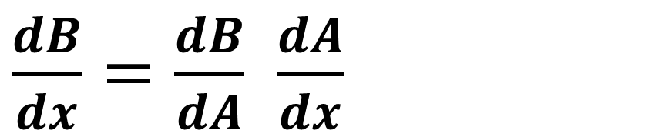
Chain Rule
x
f
A
g
B
A = f(x)
B = g o f(x)
$\frac{dB}{dx}=\frac{dB}{dA}$ $\frac{dA}{dx}$

Slide 86
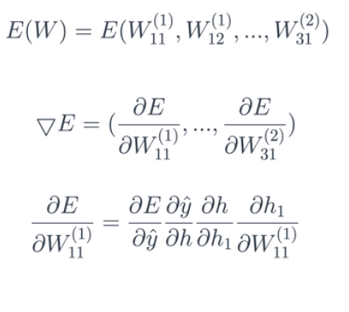
Back Propagation
Error Function
h1
E(W) =
W⁽¹⁾₁₁
W⁽²⁾₁₁
X1
W⁽¹⁾₁₂
h
yhat
W⁽¹⁾₂₁
h2
W⁽²⁾₁₁
X2
W⁽¹⁾₂₂
W⁽¹⁾₃₁
1
1
W⁽²⁾₁₁
W⁽¹⁾₃₂

Slide 87
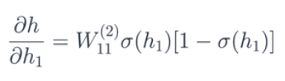
Back Propagation
h1
h = W⁽²⁾₁₁ 𝜎(h1) + W⁽²⁾₂₁ 𝜎(h2) + W⁽²⁾₃₁
W⁽²⁾₁₁
h
h2
W⁽²⁾₁₁
1
W⁽²⁾₁₁

Slide 88
X0
W0
X2
W1
….
W5
X5

Slide 89
Optimizations

Slide 90
Underfitting & Overfitting

Slide 91
Early Stopping
Epoch 1
Epoch 10
Epoch 100
Epoch 1000
Underfitting
Overfitting
Elbow

Slide 92
Quiz
(1,1)
x₁ + x₂
10x₁ + 10x₂
(-1,-1)

Slide 93
Regularization
ŷ = w₁x₁ + w₂x₂
x₁ + x₂
𝜎(1+1) = 0.88
𝜎(-1-1) = 0.12
10x₁ + 10x₂
𝜎(10+10) = 0.9999999979
𝜎(-10-10) = 0.0000000021
(1,1)
x₁ + x₂ = 0
(-1,-1)

Slide 94
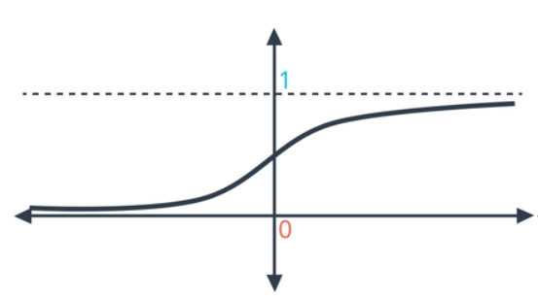
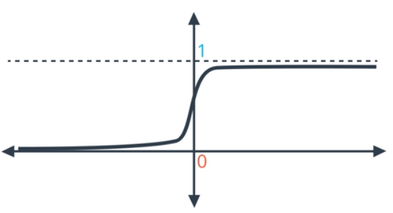
Regularization
Problem: Large Coefficients ➔➔➔ Overfitting
x₁ + x₂
10x₁ + 10x₂

Slide 95
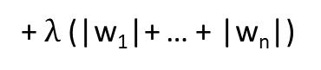
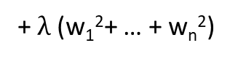
Regularization: Solution
Large Coefficients ➔➔➔ Overfitting
Penalize Large Weights
(w₁, w₂, …, w_{n})
L1
Error Function =
+ $λ$(|w₁|+ … + |w_{n}|)
L2
Error Function =
+ $λ$(w₁²+ … + w_{n}²)

Slide 96
Usages
L1 Regularization | L2 Regularization
Sparsity : (1, 0, 1, 1, 0, 0) | Sparsity : (0.3, 0.9, 0.5, -0.1, 0.2, 0.2)
Good for Feature Selection | Good for Training Models

Slide 97
Dropout
Dropout = 0.2
W¹
W²
W³
X1
W⁴
X2
1
1
1
1

Slide 98
Local Minima Problem
Local Minima
Local Minima
Global Minima

Slide 99
Local Minima Solution: Random Restart
Local Minima
Local Minima
Global Minima

Slide 100
Vanishing Gradient Problem

Slide 101
Vanishing Gradient Problem
Product of Small Numbers is….
A very Small Number
h1
W⁽¹⁾₁₁
W⁽²⁾₁₁
X1
W⁽¹⁾₁₂
h
yhat
W⁽¹⁾₂₁
h2
W⁽²⁾₁₁
X2
W⁽¹⁾₂₂
W⁽¹⁾₃₁
1
1
W⁽²⁾₁₁
W⁽¹⁾₃₂

Slide 102
Vanishing Gradient Problem
Local Minima
Local Minima
Global Minima

Slide 103
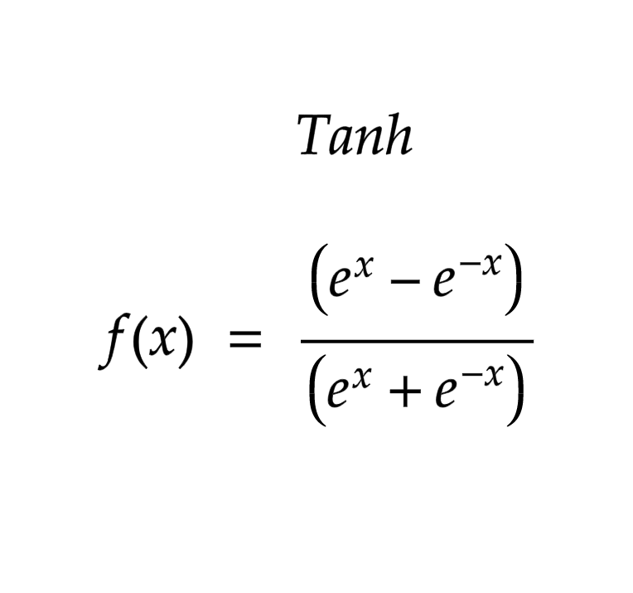
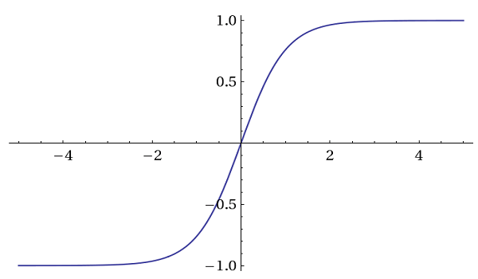
Vanishing Gradient: Solution Activation Function: Tanh

Slide 104
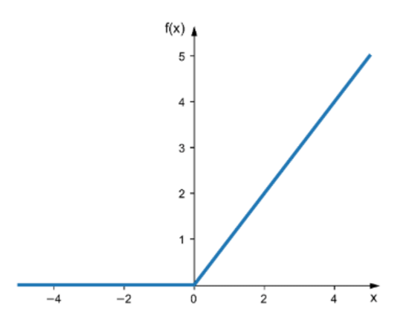
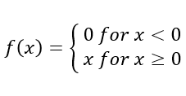
Vanishing Gradient: Solution Activation Function: ReLU

Slide 105

Summary: Activation Functions

Slide 106
Final Project
Predicting Species of Iris

Slide 107
Architect
W²
W¹
X1
W³
X2
P(A)
P(B)
X3
P(C)
X4
1
1
1

Slide 108
Intro to Instructor
I am Sajjad M.
I have Over 5 Years of Teaching Experience in University.
I have worked on a lot of Industrial Projects as well.
My Area of Interest is Data Science and Deep Learning.
I have been working with Python for over 7 years now.
Here is my email address: sajjad.Mustafa@aisciences.ai

Slide 109
Intro to Course
Introducing the Problem
Initial Solution
N-Dimensional Space
Perceptron vs Human Brain
Perceptron Training
Linear Solutions
Non-Linear Solutions
Error Functions
Sigmoid
Logistic Regression
Multiclass Classification
Multiclass Classification
Softmax
One Hot Encoding
Cross Entropy
Gradient Decent
Deep Neural Netwoks
Feed Forward
Back Propagation
Optimizations
Underfitting/Overfitting
Early Stopping
Regularization
Dropout
Vanishing Gradient
Final Project

Slide 110
Website : www.aisciences.io

